Slide 1
CS 498 VR
VR
Design & Development
Methodologies
(For internal use only)
Set 2

Slide 2
CS 498 VR: Sponsored Projects
VR Data Center (continuation of previous work) Our idea is to create a VR representation of a data center and constituent components (networking, software systems, etc.). It will provide a virtual playground to teach concepts in a real environment where students can move around and get the "real" experience. Data centers are the huge powerhouses behind modern internet services like Netflix and Google. Creating a virtual representation of one will allow students to see and work with these environments at a scale not previously possible. Students will be able to rack mount and create networks, set up software. But beyond this, students will be able to look into the machines and wires and actually see the packets in flight, the system software running and its state, peer within the routers and switches and view their protocols and operations. Our environment will also be very useful to network operators who can run "fire drills" and perform certifications/audits within the virtual environment. VR has shown to provide massive benefits to aircraft mechanics (https://www.youtube.com/watch?v=CyMzFenEuNI) and doctors (https://www.youtube.com/watch?v=x9D9eIWZNgM) and we envision to bring these huge benefits to the realm of computer science with our project. Your team will be paired with a team from Prof Matthew Caesar CS 436 course who can provide expertise on data center design and assist in prototyping.

Slide 3
CS 498 VR: Sponsored Projects
Driving Sim for KAR Automotive
This sponsor is looking to create a high-end driving simulation that allows research and data collection in support of a new driving aid. The driving model includes a navigation system, weather impact, various environments, distractions and difficult driving situations.
https://drive.google.com/open?id=1Dh3jSOa7hPui9K7iGIIPzv4jEPnu-3S0
VR Lab for ECE 329 This project group will continue to work with ECE faculty to build out the VR lab exercise app for ECE 329. The VR lab allows students to visualize electromagnetic fields and experience and explore various properties of electromagnetism.
CITL VR-ification of Lectures: work will continue on the app created last semester https://drive.google.com/open?id=1-EZ1ZRaMqILCclJDOGstq23eiKMMn6xc
Extension to the WebVR 360 tour of the Main Library Book Stacks
The plan is to add a menu system and a game based around using a conveyor from the 1980s to move large numbers of books. https://drive.google.com/open?id=19uBl1rw3Kz7npKWfSz6f8_K_ugrX2ctC

Slide 4
CS 498 VR: Sponsored Projects
French Language VR app: The goal is to create a VR environment in the form of a French Village as a backdrop for immersive use of the French Language. The time setting for the Village will be the 1960s (not much actual impact on the architecture but it will allow for interesting interactions as the project develops).
https://drive.google.com/open?id=1qz3MNPKToufpLfX1X1jCpGHSM-1R3zc2
Accountancy VR App: This app will create 3 environments in order to demonstrate accountancy principles as they apply to a startup, mid-size business and high-end international company.
https://drive.google.com/open?id=1rlbbp1gvkstKqGSmDGzGFSmJ4rdebhzP
Accountancy AR App: An App that allows the user should be able to input transactional, tax, budgetary and cash flow elements into the App so that the information can be displayed in various interrelated formats. The user will be able to manipulate the supplied data and pull up the display formats (charts and matrices) with simple gestures and potentially with voice commands.
https://drive.google.com/open?id=1r31RHiM74pf6Vz1IU2SMSmX84AmjL9Fc
Financial AR App: The goal is to create an app that can take financial/market data (either in real-time or from a database of supplied information) and display it in various forms that can then be interacted with or manipulated.
https://drive.google.com/open?id=1Zop8a0hqv8EHfCdYPqz60aOXGY_VHEW3

Slide 5
CS 498 VR: Sponsored Projects
Interactive VR recreation of the Illini Quad during the 60s and 70s: The goal of this app is to build a recreation of the Illini Quad during the tumultuous times of the late 1960s and early 1970s. Users would experience different interactions based on their chosen appearance. Issues include racial tension, feminism, anti-Vietnam War protests, and gay rights.
https://drive.google.com/open?id=1aeeM6CH_g1jcQBj8soBInz711U1BjCJO
Virtual home fall risk assessment: This is now an AR app based around scanning a space looking for situations that could cause a fall.
https://drive.google.com/open?id=1Jn4qY_VOPei67ZQudjzO-3N8Y0Ar4wxY
Hazards and risks of injury in auto industry: This is now an AR app based around scanning a job site and finding specific risks of injury and potential hazards.
https://drive.google.com/open?id=1ri_d_wK07BVrQW4KksSLwFSRtnZD8bh4

Slide 6
CS 498 VR: Sponsored Projects
Drop jump simulator (continuation): The goal is to create a VR app to simulate drop jump landing on different ground surfaces. The virtual reality environment will allow for the simulation of drop jump landings to different surface conditions, which require different coordination patterns for landing safely, which could be detected using in-lab sensors. https://drive.google.com/open?id=1iDlV5JtYV77EvwIYBGxw67eFZJ6avKrp
Virtual obstacle navigation (continuation): The goal is to create an app that will allow the user to see either 1) 3-D blocks that must be avoided or 2) numbers and letters overlaid on the surface of the floor to step on, that are coinciding with the projection of white rectangles on the ground or an instrumented treadmill. This app will allow for a novel clinical assessment of cognitive and motor function in older adults, by monitoring gaze and foot placement on the ground, relative to the obstacles or targets. https://drive.google.com/open?id=11Yom1Yz8wtFdSs6ASwyuQUHmtAxSn8L8
Paddle Boarding Simulation (continuation): The goal is to create a VR app to simulate paddle boarding on 3 different environments that would require different challenges in maintain balance. The virtual reality environment requires environments of constant aesthetic for the background, foreground, and water elements, and the combination of visual and auditory elements to increase interactivity in the environment. The virtual reality environment will provide a testbed for testing and training using an actuated platform and wireless sensors to monitor performance. https://drive.google.com/open?id=1MfRntGFFHJjo03ASvsChs2SVwxJs8dEH

Slide 7

Principles of Design: Starting Points
All apps/games start with an IDEA
There is so much more to what you want to build
The primary role of a designer is to clearly communicate how that IDEA fits into an App/Game (the bigger picture, the Vision)
What happens without that clarity?
Confusion
Delay
People building to their own vs. the required standards
The question is: what focuses the design, what drives the definition of the Vision?

Slide 8

Principles of Design: Starting Points
Once you have an idea, build a world around it
Provides Context
Provides Consistency
Expand upon the idea to provide depth
An idea is a feature in most cases, a feature is not a game
Why is the world the way it is? Leads to new complementary ideas
Examples: Renegade and Red Faction Guerrilla
Improve Immersion/Presence
Most games are Skill Challenges
Skill develops over time, the world encourages retention
Interactivity can add another layer

Slide 9
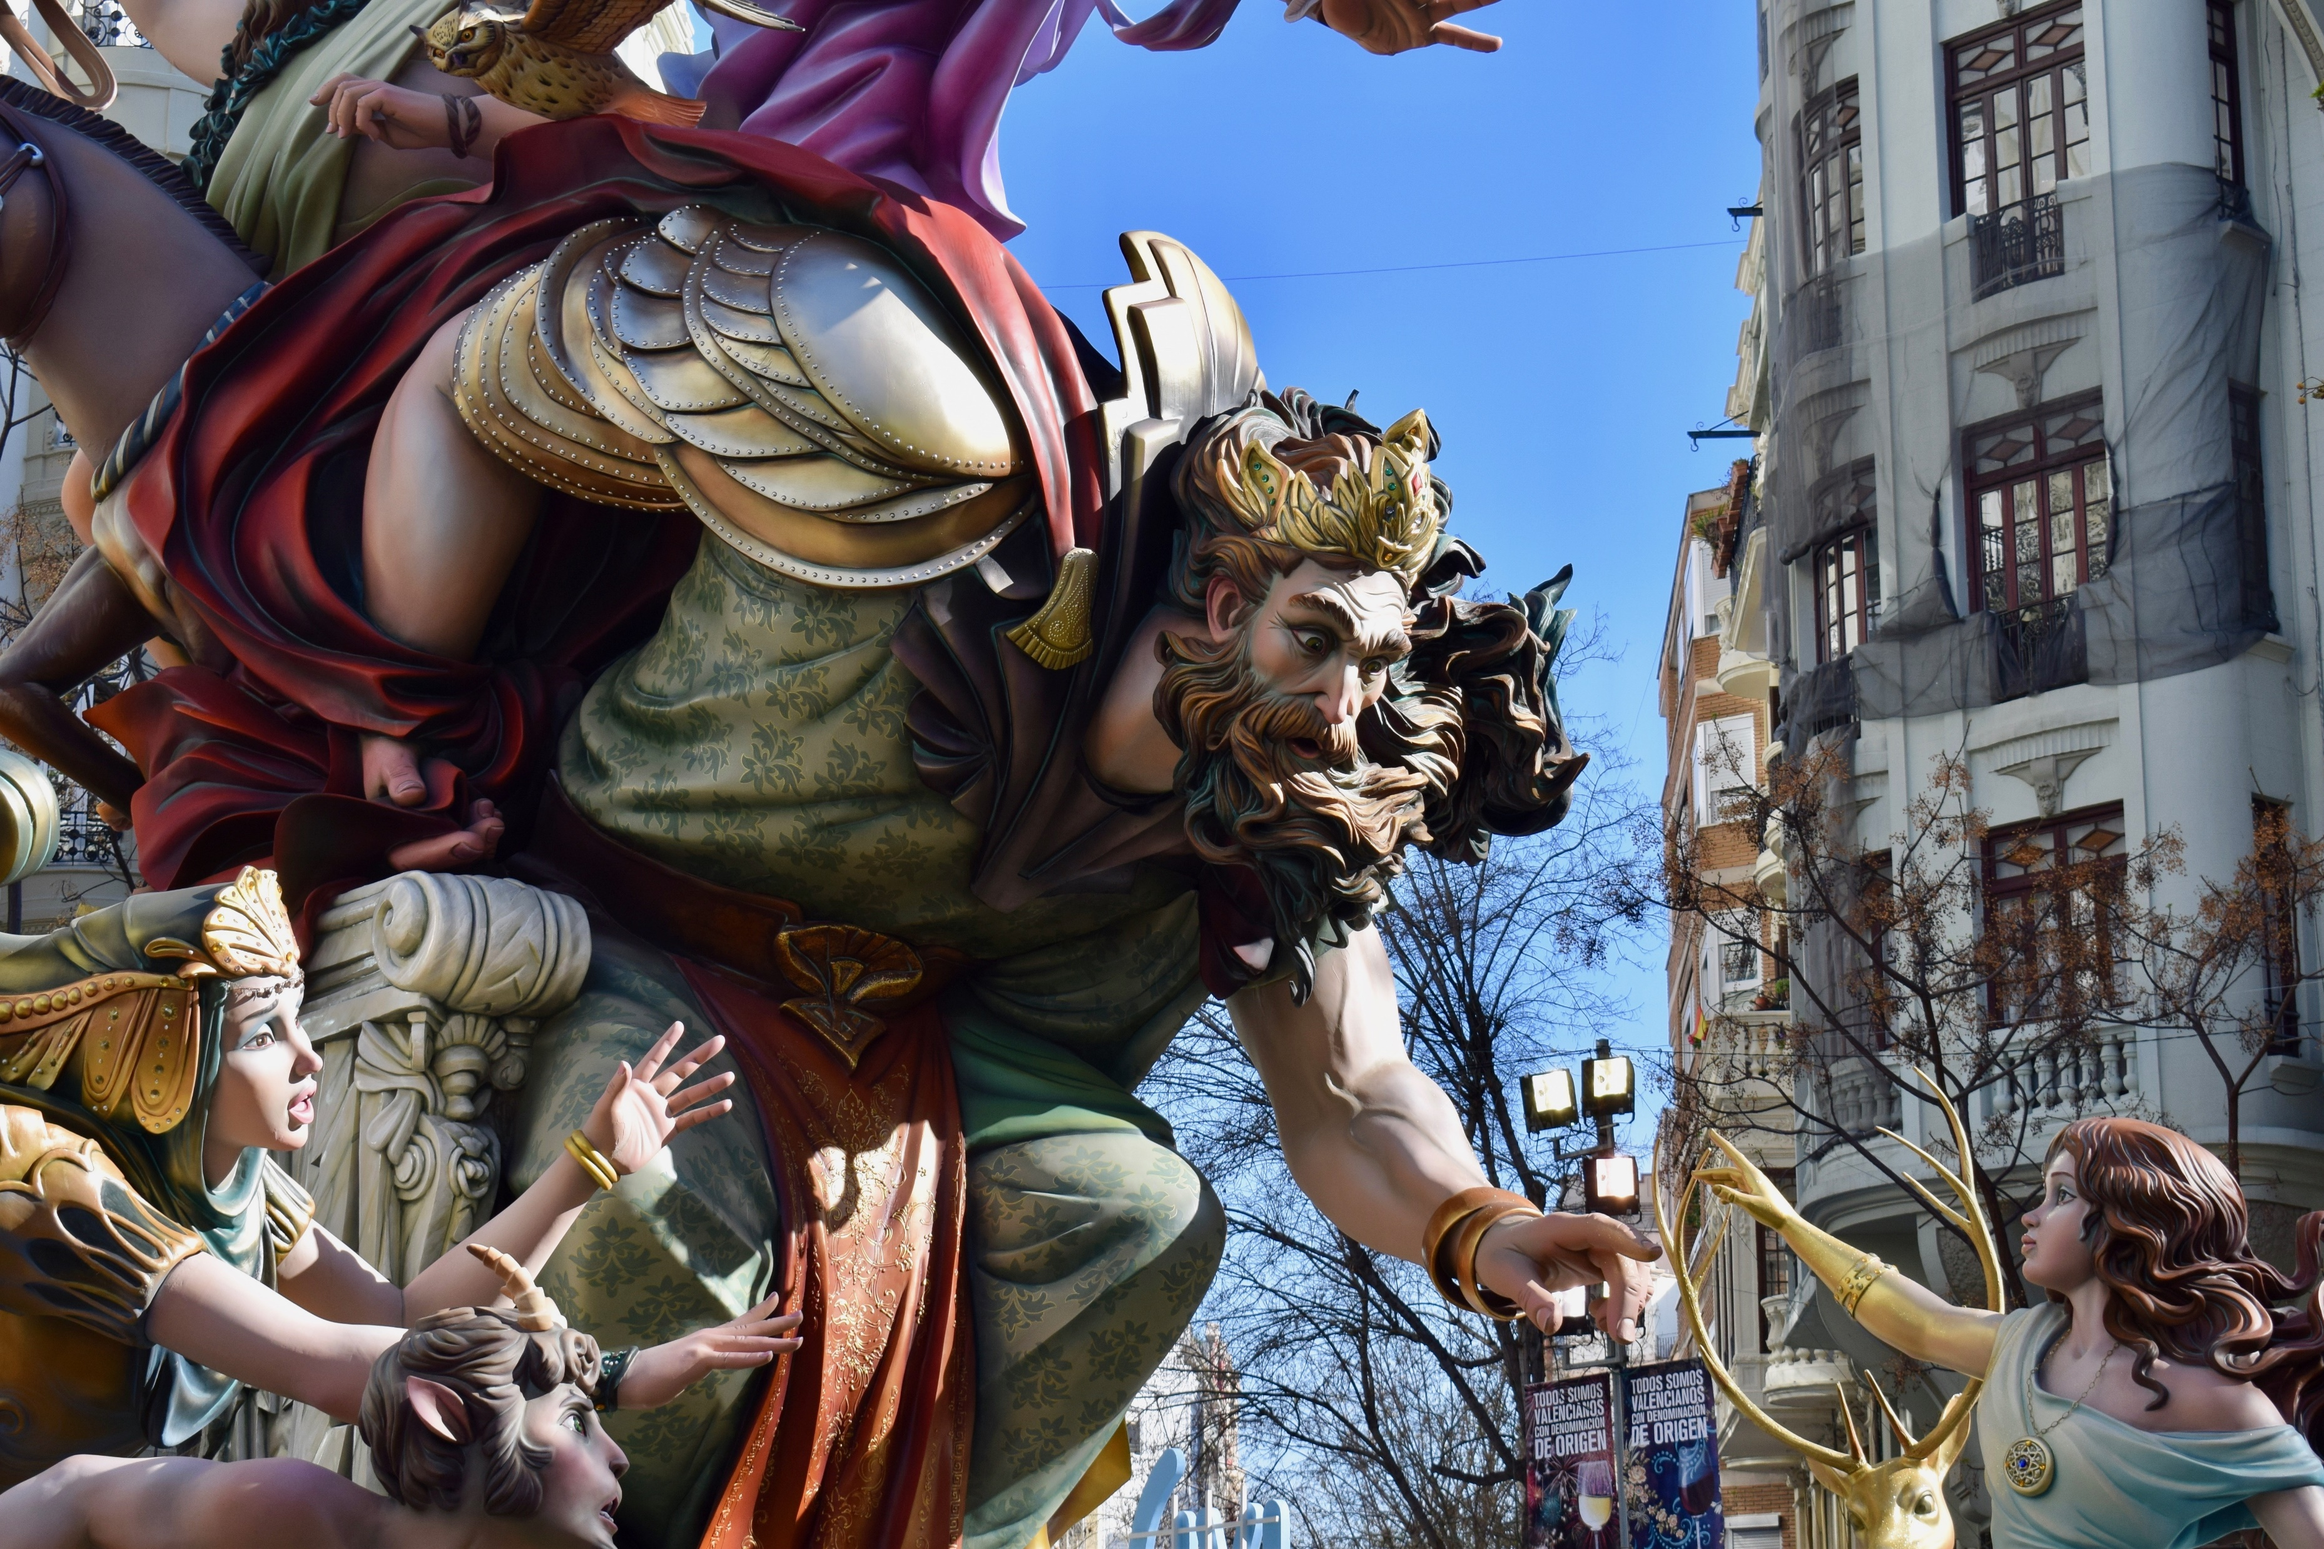
Principles of Design: Defining a World
Art Style
Environment
Characters
Personas
Skills
Culture
History
Beliefs
Relation to the real world:
Is it realistic?
How does it vary?
Examples:
Candy Crush, Elder Scrolls, Saints Row (Characters)
https://www.dreamstime.com/publicdomainphotos_info

Slide 10
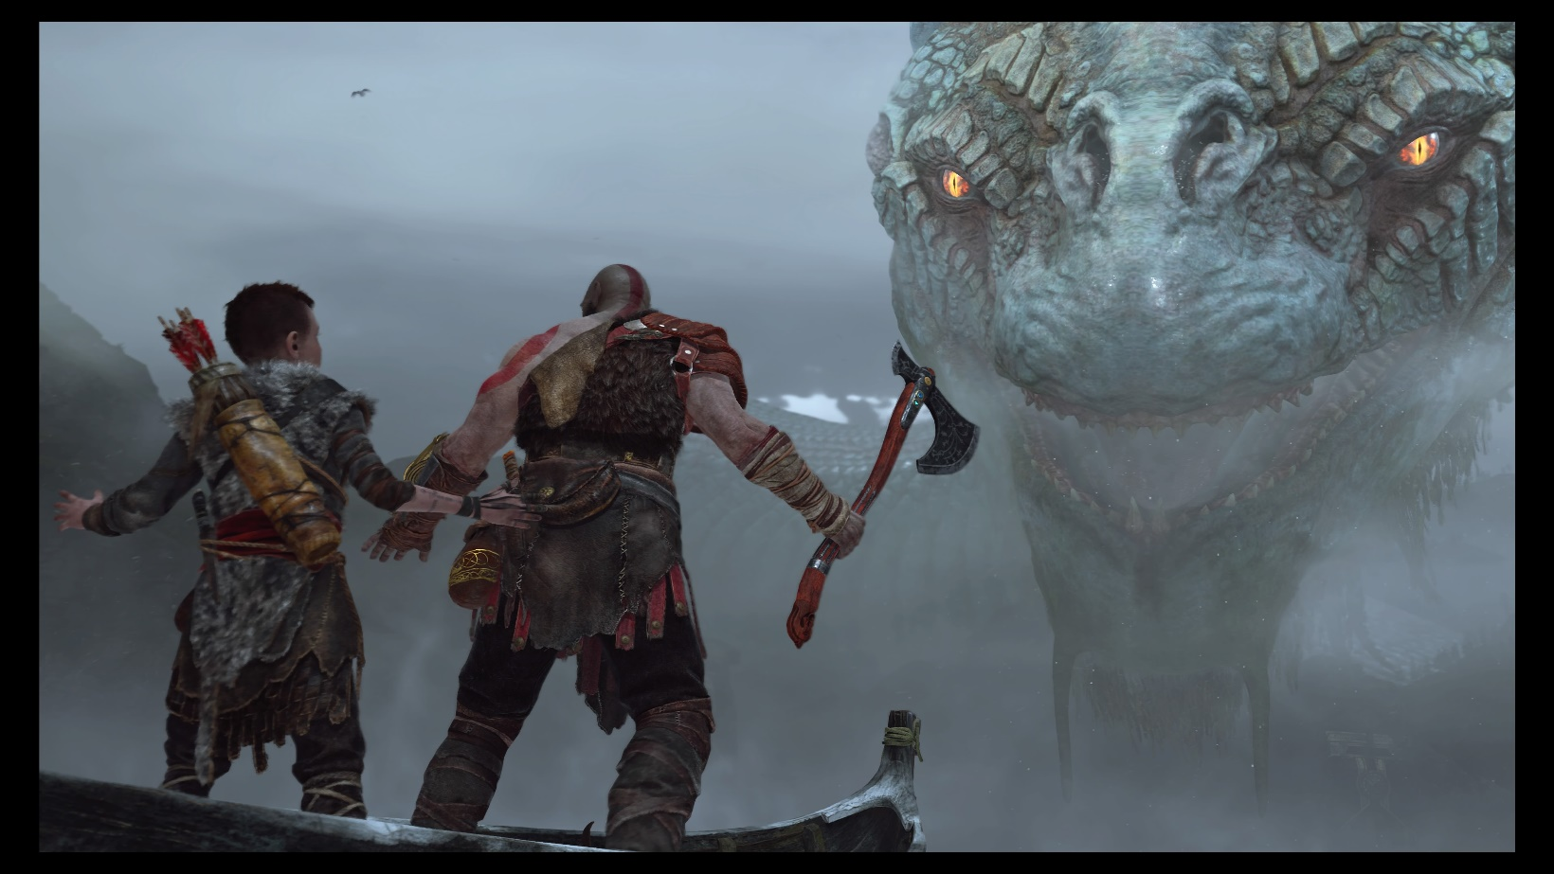
Principles of Game Design: Starting Points
Determine your constraints.
Constraints lead to better designs
Genre and IP/Genre are constraints in themselves
Define your User Experience(s):
The different emotional responses we are trying to elicit with our app/game features
Example: We want the gamer to be in awe when they face the challenges of our world.
Copyright God of war 4

Slide 11
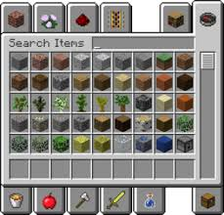
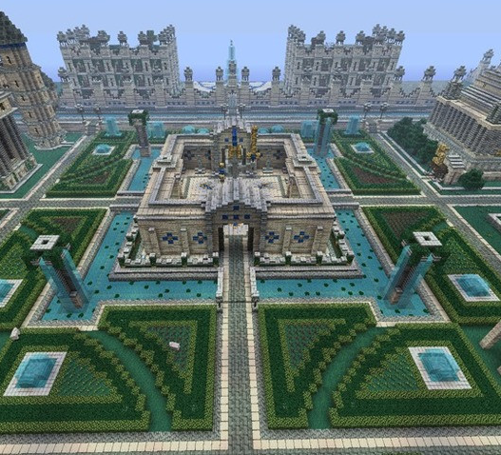
Principles of Game Design: Starting Points
User Types: These define the core interests of the user we are targeting with our features.
Example: Minecraft
The Collector:
This user requires the opportunity to gather items and build a large stockpile of items.
The Builder:
This user type enjoys creating different imaginative items from the resources available.

Slide 12
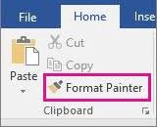
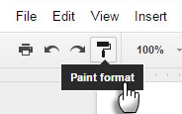

Principles of Design: General
Design from the user’s perspective, their experience:
What are they seeing, thinking and FEELING as they move through your app/game?
Fulfill the user’s low-level expectations, make them feel comfortable
Think about the difference between Microsoft Word & Google Docs Format Painter
Make the user’s path or choices clear and meaningfulayers want to be successful (remember to avoid punishing failure)

Slide 13
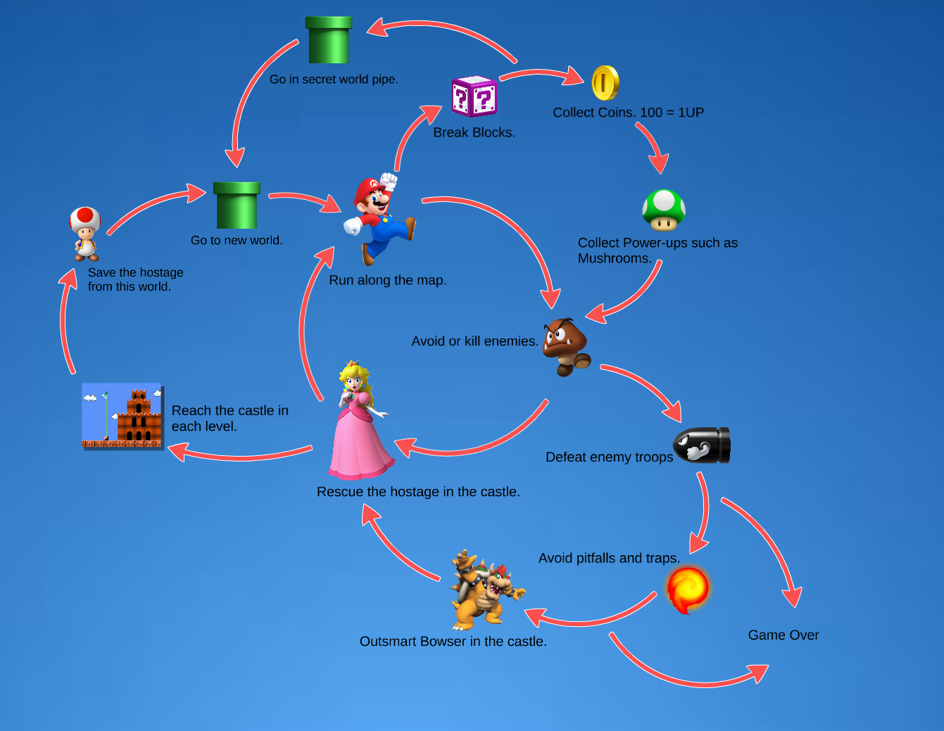
Principles of Game Design: General
Everything you design should be a loop
Most Skill Test Games use the following low-level loop:
See enemy, engage enemy, kill enemy, loot, repeat
Turn based and RTS games often use this low-level loop:
Select unit, move unit, combat/gather, repeat
By Ethan Stanaway https://prezi.com/gyqljrywdmzu/super-mario-bros-core-game-loops-and-reward-structures/

Slide 14

Principles of Game Design: General
Immersion
We will talk quite a bit more about this
VR has a different set of issues in this area
Absence is the enemy
When something is missing it is stands out

Slide 15
Principles of Design: For Games
REMEMBER to Iterate to fun
Don’t trust your view of fun
Get audiences of people that fit your player types to test your game
When they tell you its fun you have something

Slide 16
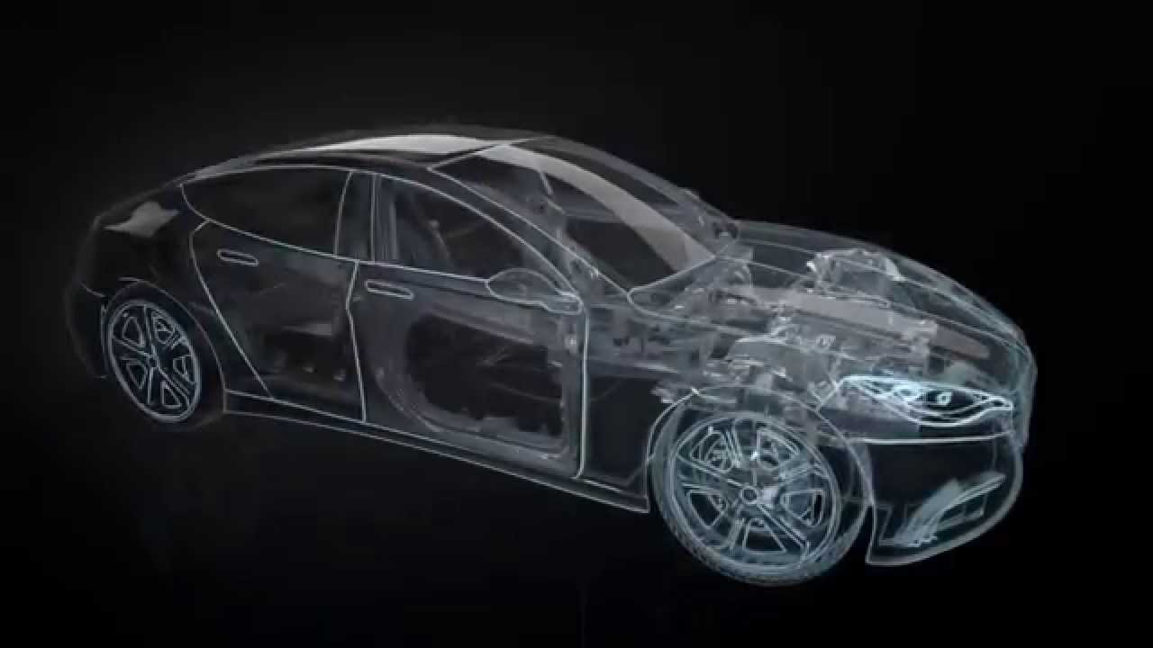
System Driven design (or as I call it, Top Down Design)
Analogous to Automotive Design
User types
User experiences
Systems first then features
Getting better at the process
We are a young industry
GTA2
Ubisoft
Copyright Fisher Automotive

Slide 17
The Top Down Design Process
We are going to put you on a team
If not a Sponsored Project, your team will decide on a design
Your team will figure out your audience and then create a High-level Vision Canvas
User Experience
User Types
Do a mid-level breakdown of the design leading to a strong list of features
Game Loop: Mid level action flow (still fairly general) showing how the app/game works
Beat by Beat: Narrative walk through of the actions/play used
Create a prioritized list of the features/systems in your app/game
This will give you the elements you need to start building your project plan

Slide 18
Vision Canvas
The layout is important
App/Game Name
Descriptive
Genre
World
Inspirations
Targets
User Experience
User Types
Foundational
Core Pillars
Core Systems
High Level Vision Canvas
App/Game Name
Inspirations (note what it is inspiring) | Genre (ex: RPG, Travel) | Core Pillars (in the form "Player can...") | Core Systems (ex: Save/Load or Combat) | User Experience (the emotion elicited)
 | IP/World (ex: Sci-fi, Beach)
 |  |  |  | Player Types (rank by priority)

Slide 19

Considering/Describing the Audience
Design requires consideration for an audience
Designers often design for an audience of 1
Platforms help define the audience
Mobile, iOS
Console/PC
The style provides another level
First person/3rd/God game (real time/turn based)
Non-game apps have methods/styles users expect
Genre can constrain it even more
RPG, Open World, Shooter, Platformer, etc.
Spreadsheet, Written Doc, Travelogue, etc.
Of course it all blends somewhat but people have preferences
And you can go even lower (we defined our own)
In games we use: rule breaker, grinder, collaborator, customizer
Define them any way you want but be consistent and make sure the team understands the target.
You Suck

Slide 20
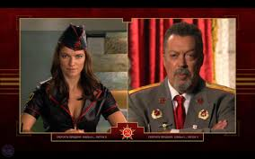
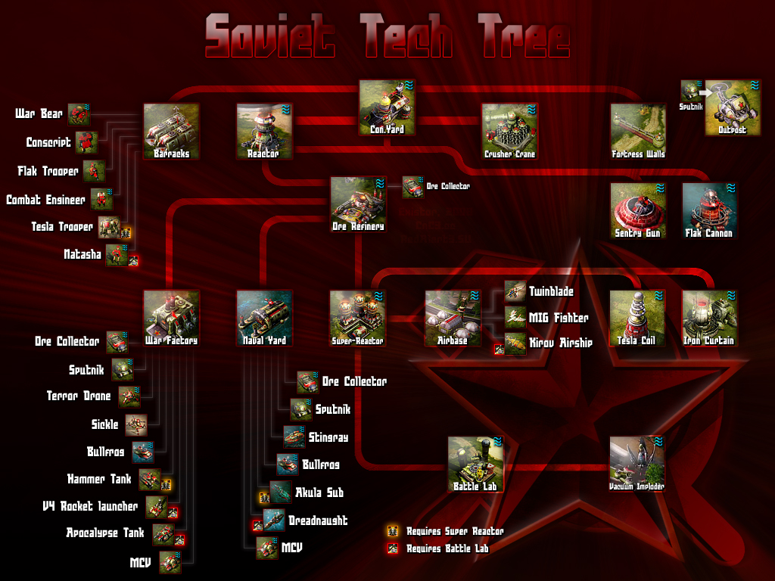
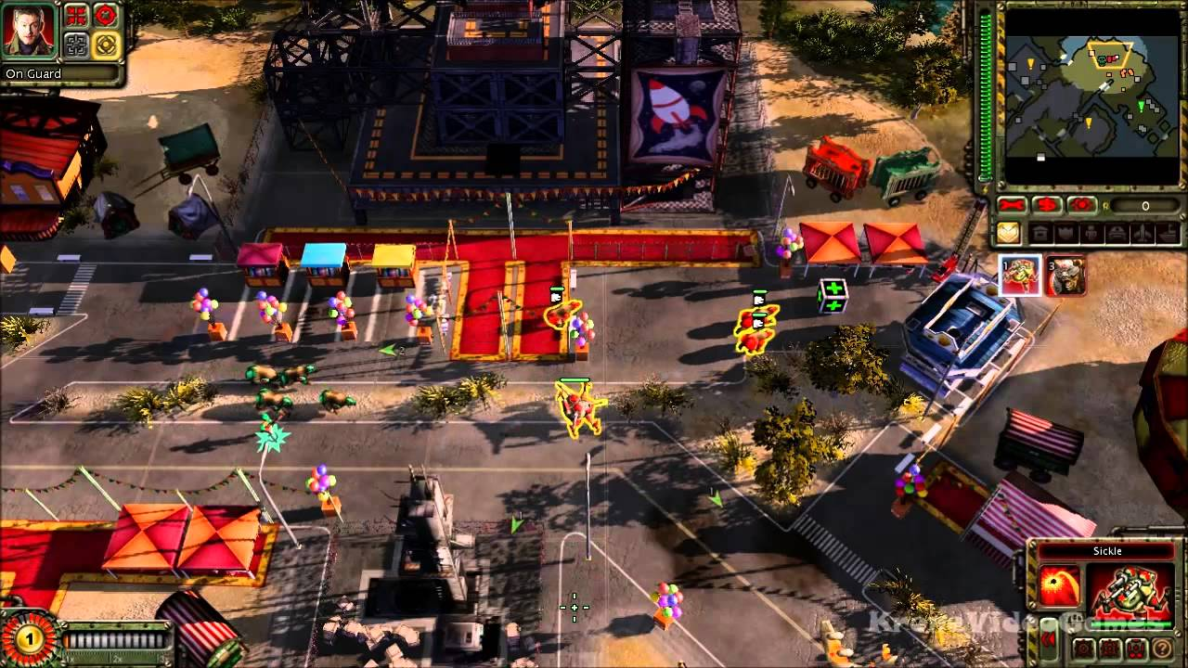
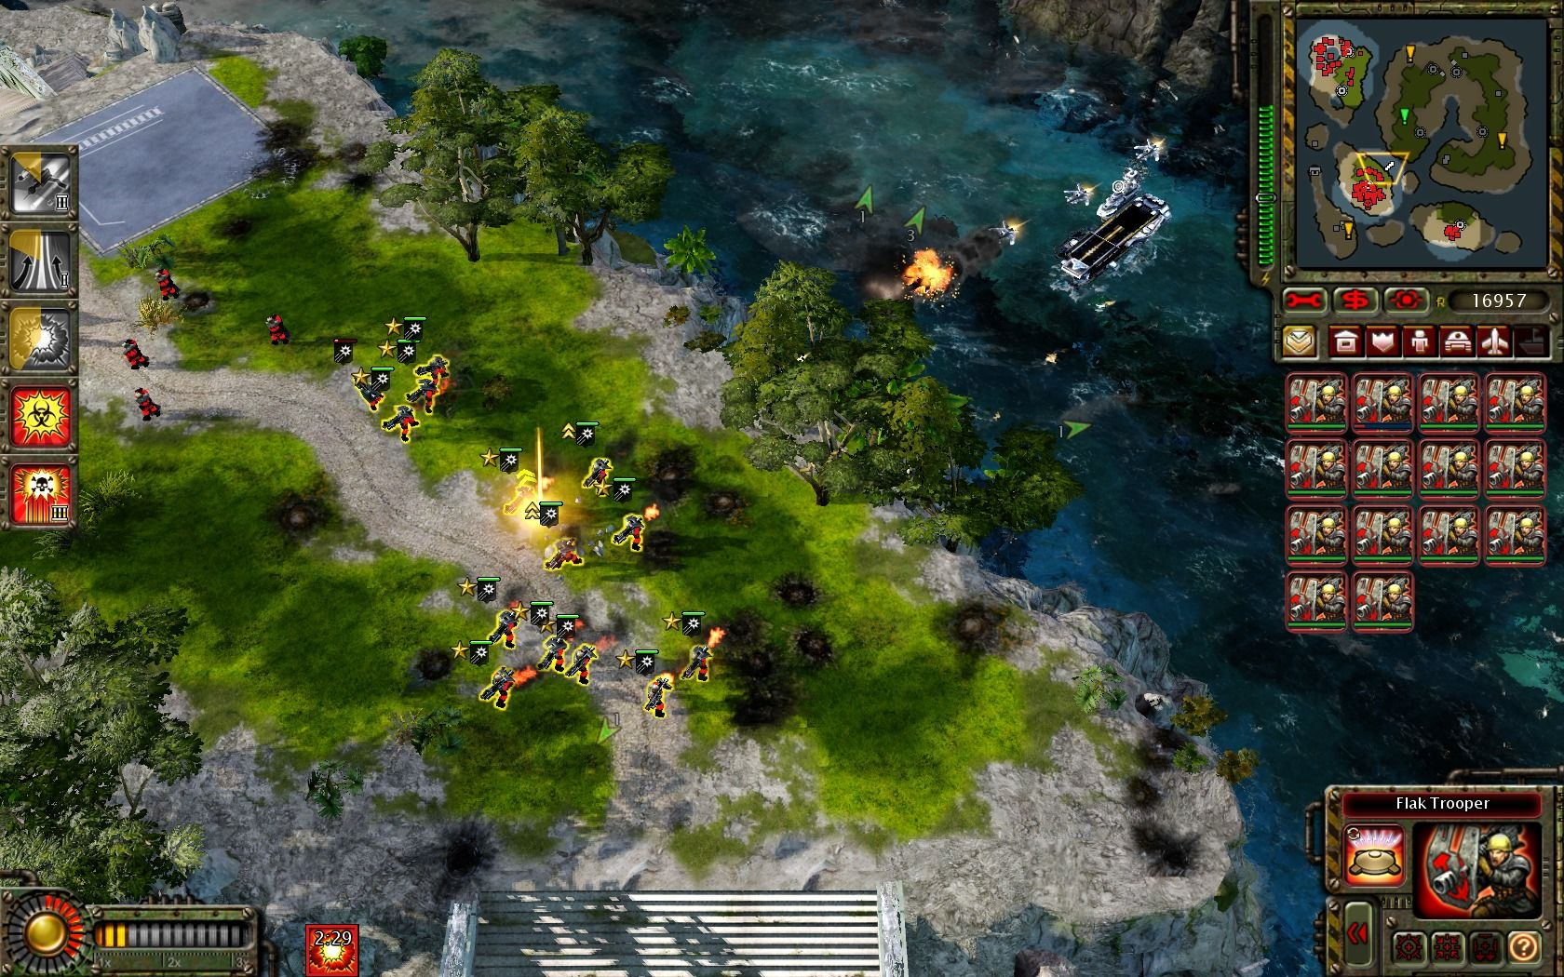
Vision Canvas: App/Game Specifics
Core Pillars
High Level elements that drive the Player Experience (Red Alert 2, Westwood)
The user will …..
Core Systems
Systems that support key actions in the app/game
Points to key low-level systems
Examples: Navigation, Melee combat, etc.

Slide 21
Design Docs Process: Simple Action Loop
Win/Lose, no repeat
Lose, repeat
Start
S01
Home Base
S02
Mission
S03
Combat
S04
Death

